Slide 1
LPC-10 Speech Encoder Implementation
December 16, 2020
Karndeep Singh Rai-Bhatti
Key take-aways are highlighted in blue.

Slide 2
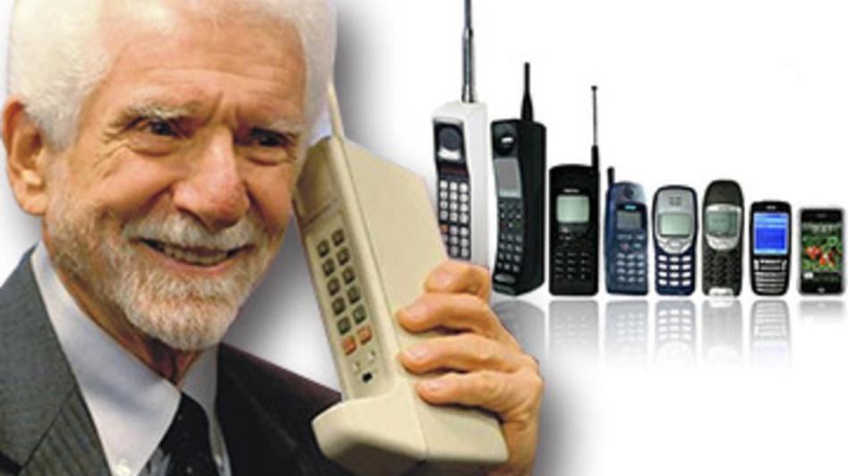
Motivation
Speech compression for communication systems
Telephones
Voice over IP
Videoconferencing
Maximize audio data compression
Without corrupting the words being spoken
Retaining an intelligible voice
Additional Security - encryption
Model that Emulates Human Speech Generation – Physical Model
We want to maximally compress audio while preserving voice and meaning.

Slide 3
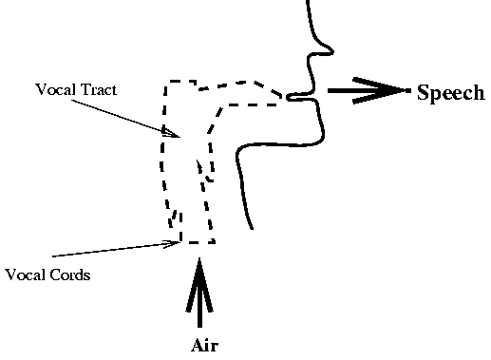
Physical Model of Speech and Synthesis
Air ~ Speech volume
Gain
Vocal Cords ~ Excitation signal
Impulse train
Period = fundamental Frequency of voice
Vocal Tract ~ Linear Transformation
Modeled by All Pole System
Our Linear Predictor
Speech ~ Output signal
Pass excitation through filter with appr
LPC10 models speech synthesis based on the human vocal tract.

Slide 4
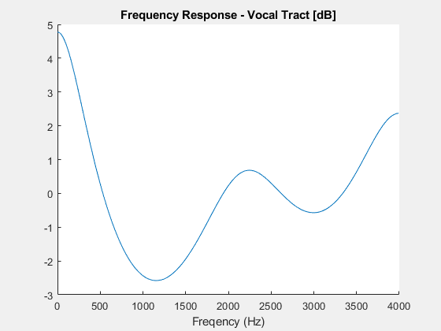
Modeling Speech as a LTI system
Model holds true at small intervals (25ms)
Unvoiced is approximated as 4th order all-pole filter
Voiced is approximated as 10th order all-pole filter
The Vocal Tract is modeled as an LTI all-pole filter.

Slide 5
LPC-10 workflow
ENCODER
Signal
Pre-Emphasis Filter
High pass
Parameter Coding
LCP Analysis
All Pole Coefficients
Gain, Pitch, and Voice Analysis
Gain, Pitch and Voicing
DENCODER
Parameters
(Gain, Pitch, Voicing, Coefficients)
Pitch, Voicing
Excitation Generator
Impulse train
Synthesizer
Gain
Reconstruction
All Pole Coefficients
LPC10 is an encoder-decoder network.

Slide 6
What did I do?
Implemented LPC-10
Look at system holds up to different users and emotions
Attempted to Improve LPC-10
Voiced detection
All-Pole Filter
Pitch Interpolation
Gain Interpolation
Implemented LPC-10 in real-time using MATLAB
I implemented and qualified LPC10, attempted to
improve the algorithm and implemented it in real-time.

Slide 7
Data Set: EmoV-DB
Databased for characterizing how Emotionally Expressive a Voice Generation System is
4 Speakers
Bea & Jenie (female)
Sam & Josh (male)
All Bea data recorded at 44k, so it was excluded
5 emotions
Neutral, Sleepiness, Anger, Disgust, Amusement
We will look at Neutral, Anger, Sleepiness
Use to assess the quality of our LPC-10 Reconstruction
https://github.com/numediart/EmoV-DB
The encoder was tested on both genders and for 3 extremes of emotion.

Slide 8
Emotions and Signal Periodicity
Emotions tied to periodicity of speech signal
Anger/Strong Emotions: Expect More Periodicity
Expection: Ideal case for model
Fatique/Weak Emotions: Speech becomes more Aperiodic
Expectation: Model will perform more poorly
LPC-10 relies on the assumption that speech is periodic at small time scales (ms)
Test the robustness of the algorithm
Emotion is tied to the periodicity of a speech waveform.

Slide 9
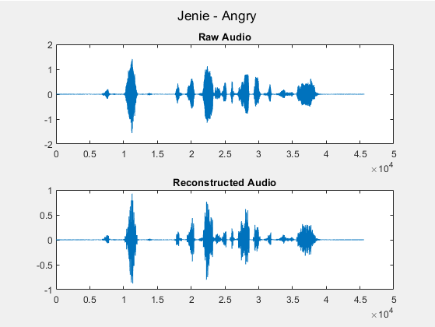

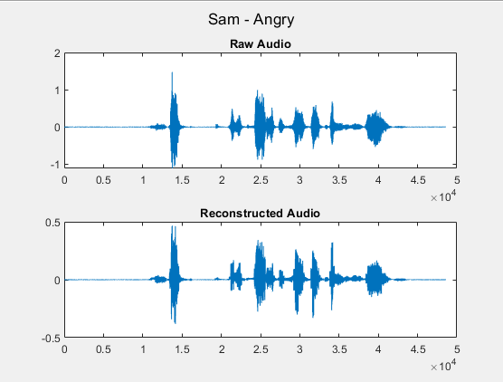
Angry Audio – LPC10
Periodic Signal
Waveforms matched closely
Audio suffers from distortion, primarily when volume peaks

Slide 10
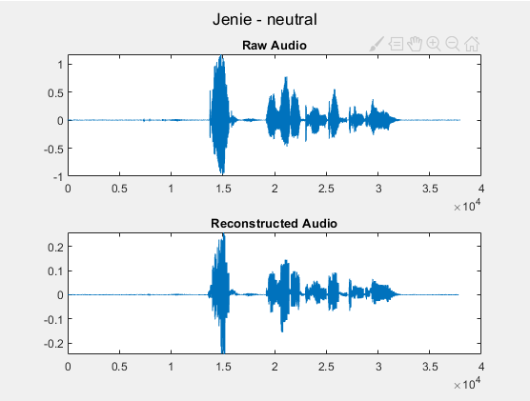
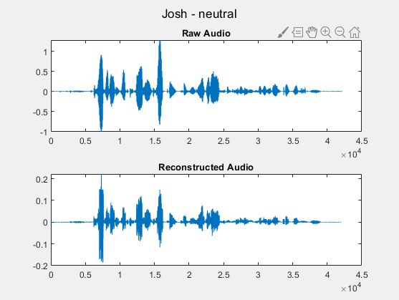
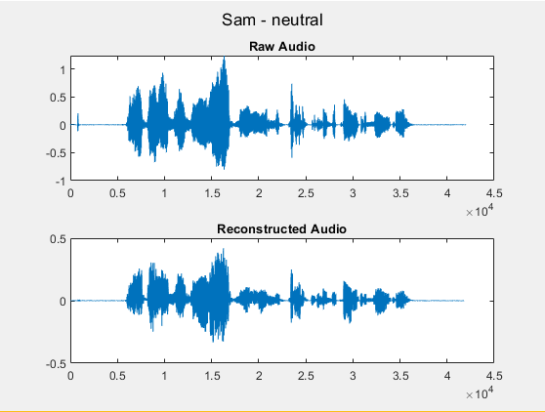
Neutral Audio – LPC10
Appears to work a lot better on female voices
Cadence of Voice significant factor in clarity
Reduced distortion compared to Angry speech

Slide 11
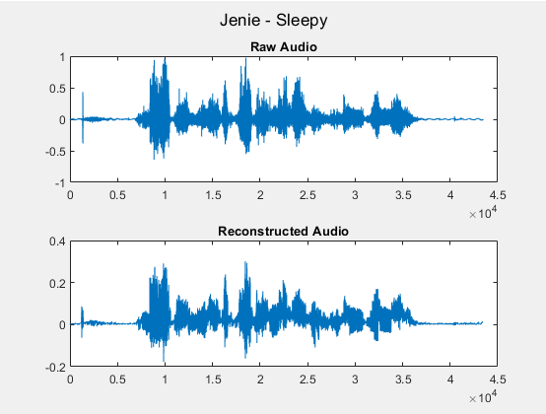
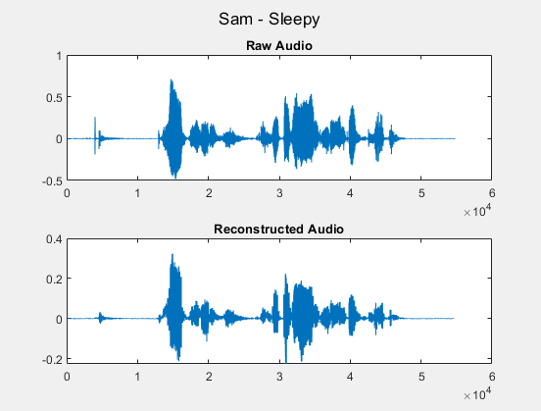
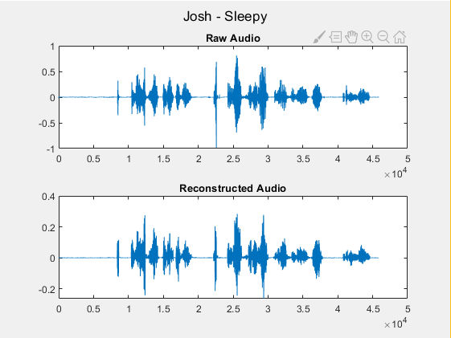
Sleepy Audio – LPC10
Non-vocal noises handled poorly (high frequency jitter)
Reconstruction is very ‘Breathy’
Slow speech significantly easier to understand

Slide 12
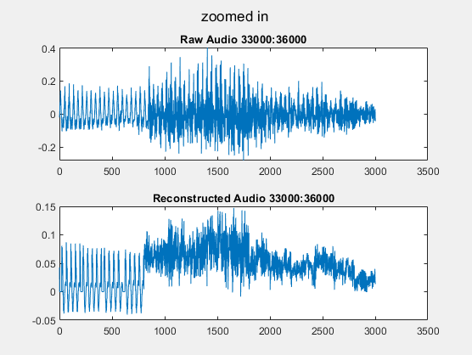
Limitation of LPC?
Distortion – failed prediction
Voiced Determination? (all prior used zero crossing)
Increase number of coefficients?
Linear Predictor performed poorly at times, investigated a solution in the next slides.

Slide 13
Voiced Detection – Energy vs Zero-Crossing
Energy Based Approach
For a speech clip:
Absolute value ()
Summation ()
Normalize to clip length
If energy > energy Threshold
Speech
Else
Noise
Tests Energy or Volume
Zero-Crossing
For a speech clip:
Turn in 1s -1s depending on sign
Take derivative
Count number of flips (zero-crossings)
Normalize to length of clip
If # zero crossings > crossing Threshold
Noise
Else
Speech
Test Periodicity
Voicing detection was done using two different metrics.
Each resulted in a different audio signature.
Notes:
Noise clip will constantly meet this metric

Slide 14
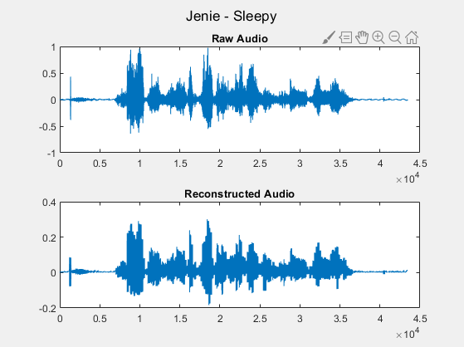
Voiced Detection – Jenie-Sleepy
Energy Based Approach
Better preserve of Pitch
Zero-Crossing
Less noise/artifacts

Slide 15
Coefficient Estimation – Number Coefficients
N = 10
Used in official Standard
Tested on very clear sample
N = 5
N = 20
N = 40
Test using both Voicing methods
Explored how the filter order impacted synthesis quality.

Slide 16
Coefficient Estimation – Number Coefficients
Energy Based Voice
N = 5
N = 10
N = 20
N = 40
Zero Crossing Based Voice
N = 5
N = 10
N = 20
N = 40
Significant increase in quality for both!

Slide 17
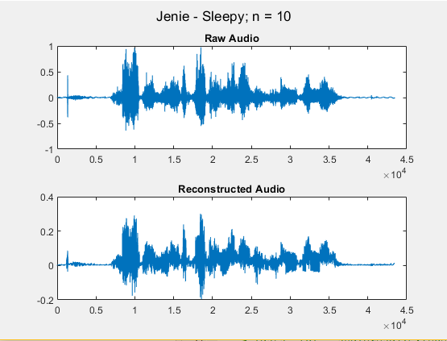
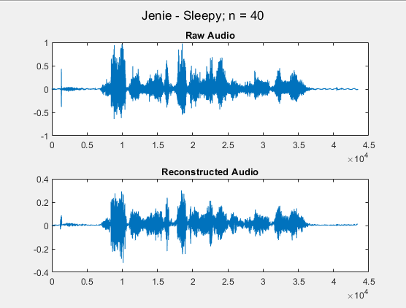
Coefficient Estimation – Re-visit Sleepy Jenie
LPC n = 10
From Before
LPC n = 40
Subjectively better, later portion
Notes:
Up to this point: We can see increased number of coefs does wonders and how sound made by the two different voiced algorithm appears

Slide 18
Improvements to LPC-10: Interpolation
Attempted to improve audio quality by interpolating pitch and gain between windows

Slide 19
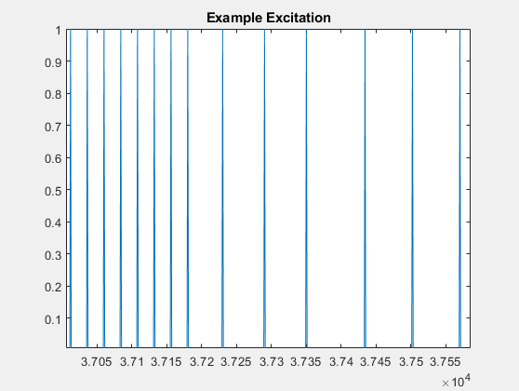
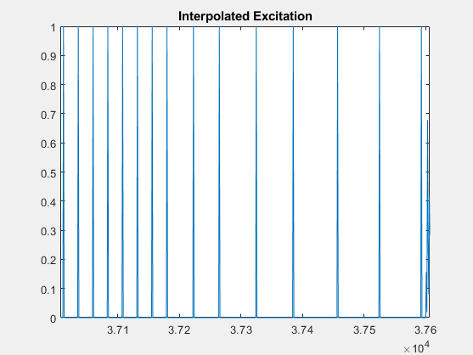
Pitch linear interpolation
Pitch calculated on a window to window (200 samples)
Idea: Linearly interpolate period from prior window
Problem: Signal Period is Large Relative to windows
Shift correction
Phase correction works great!
Pitch interpolation has negligible effect.

Slide 20
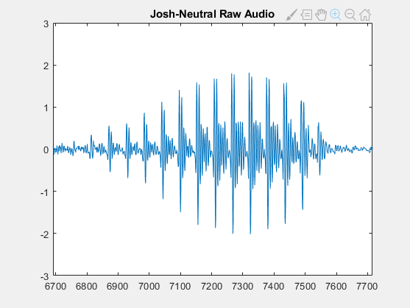
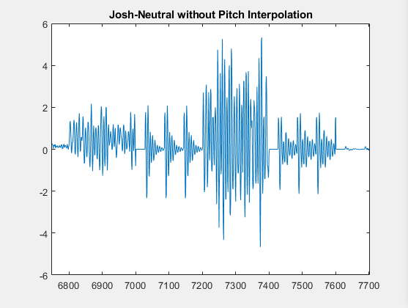
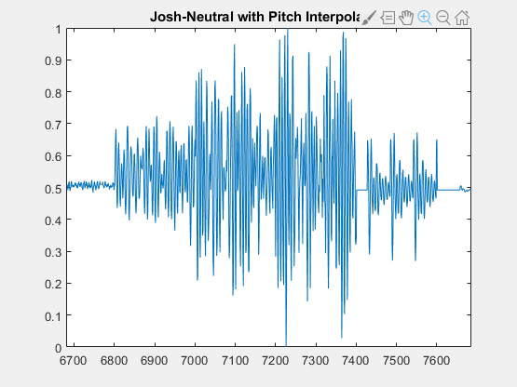
Pitch linear interpolation - Results
Also Tried on Sleepy Sam:
Without With
Pitch interpolation – Clearer
Shift correction reduced some artifacts
Note: Past data has the shift correction.

Slide 21
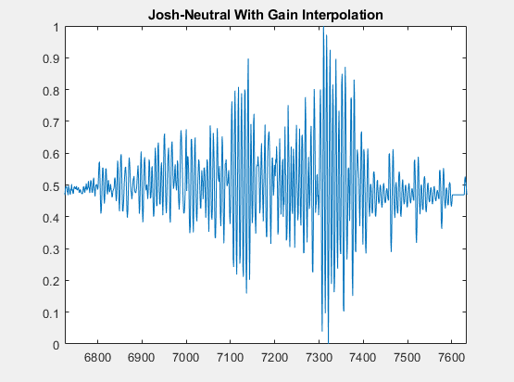
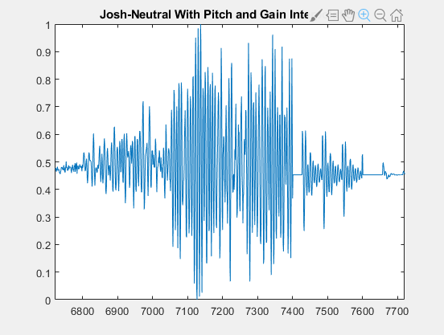
Gain Interpolation
Pitch interpolation only:
Apply an envelope to signal
Linearly Interpreting gains of each bin
Reduces Artifacts
Gain interpolation slightly reduces high frequency artifacts.

Slide 22
Real Time LPC demo
Compare different filter orders
Has shift correction implemented

Slide 23
Work Cited
Spanias, A. (1994). Speech Coding: A Tutorial Review. Proceedings of the IEEE, 82(10), 1541-1582. https://doi.org/10.1109/5.326413
Kang, G., & Everett, S. (1985). Improvement of the excitation source in the narrow-band linear prediction vocoder. IEEE Trans. Acoust. Speech Signal Process., 33, 377-386.

